Slide 1
Data Management for Dynamic Multimedia Analytics and Retrieval
PhD Defense
Ralph Gasser <ralph.gasser@unibas.ch> Databases and Information Systems (DBIS) Group, Department of Mathematics and Computer Science, University of Basel
Basel, 28 November 2022

Slide 2













Motivation: Multimedia is Ubiquitous
Multimedia Retrieval
Social Media Analysis
Signal Analysis Medical Domain
Storing Large Data Collections
Images, videos, audio, 3D
Low-frequency changes
Finding Items of Interest
“Needle in the haystack”
Short-running queries
Collect Data over Extended Time Period
Text, images, videos etc.
High-frequency changes
Generating Insights
Trends, engagement, interest
Short and long-running queries
Simulated Data Dictionary
Abstract signal data
Little to no changes to data itself
Quantification of Tissue Properties
Highly optimised application
Potentially long-running query
Notes:
Private data collections
Social Media (TikTok, Instagram etc

Slide 3



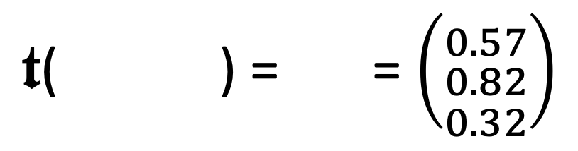
Multimedia Data
Multimedia data is often unstructured (raw signal data)
→ Disconnect between data stored and information searched → Derivative representations required
→ Semantic gap
We usually make multimedia data accessible by metadata
→ Technical metadata (e.g., resolution, geo references) → Textual descriptions / labels / annotations
→ Abstract features (e.g., salient colours)
Different types of metadata can be searched differently
→ Boolean retrieval (exact matches)
→ Similarity search (fuzzy)
outdoors
rabbit
bunny
Nutello
$𝖙$( ) = = $\left({0.57 \atop \begin{aligned}0.82 \\ 0.32\end{aligned}}\right)$
Feature transformation
$$𝕆→ 𝔽$$

Slide 4
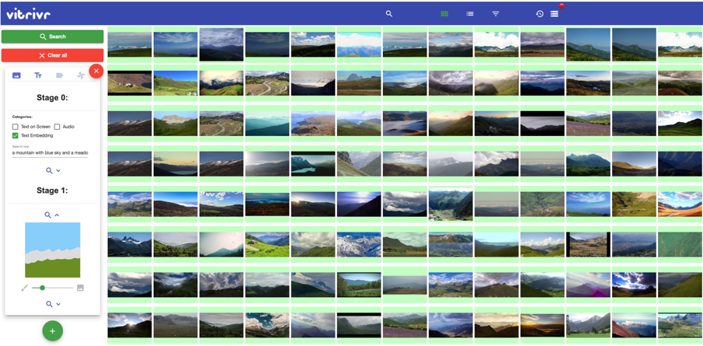
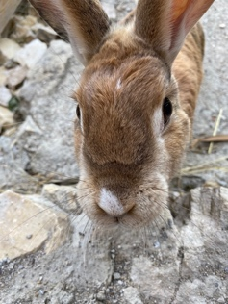
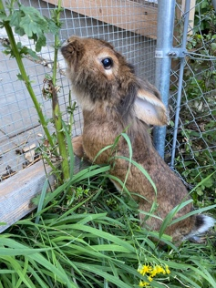
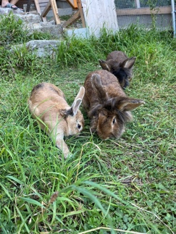
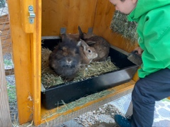
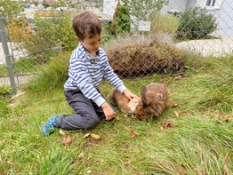
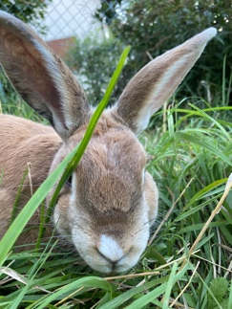
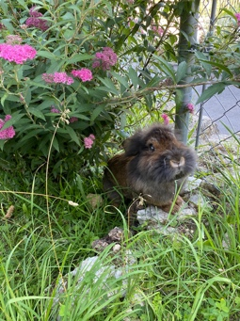
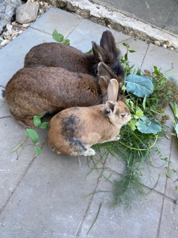





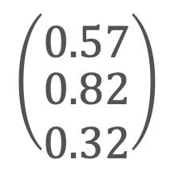
Data Management in Multimedia Analytics (and Interactive Retrieval)
Interaction
Visualization
Mapping
Data
Building
Visualization
Knowledge
Transformation
$$\left({0.57 \atop \begin{aligned}0.82 \\ 0.32\end{aligned}}\right)$$
outdoors
rabbit
Data Mining
bunny
Models
Refinement
Database
Seebacher et al. (2017). Visual Analytics and Similarity Search: Concepts and Challenges for Retrieval Considering Users, Tasks, and Data

Slide 5
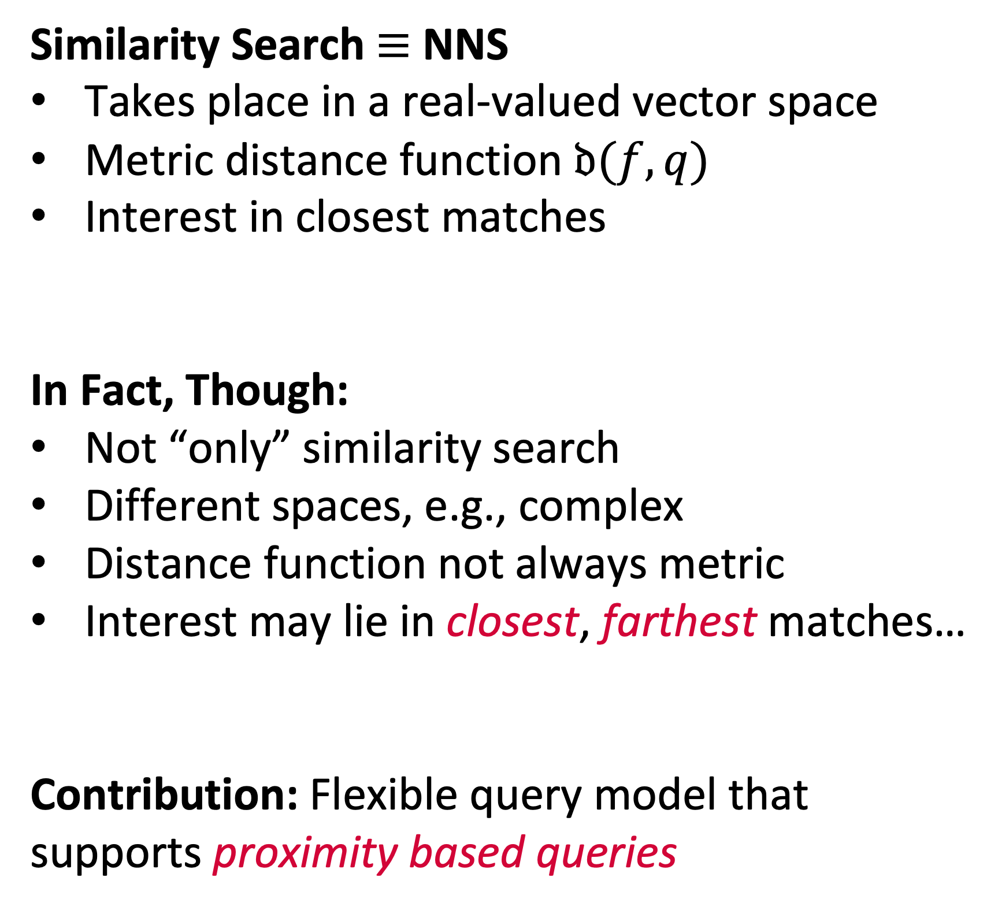


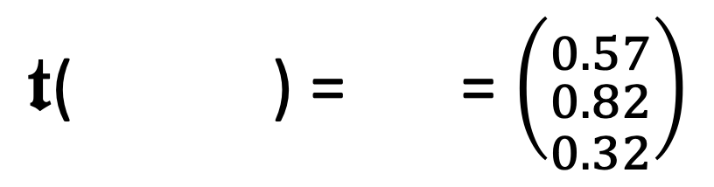
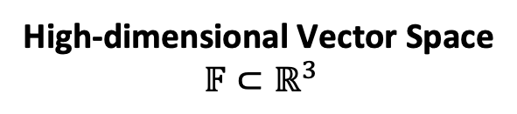
Challenging the Status Quo in Multimedia Data Management Assumption 1 / Similarity Search
Similarity Search $≡$ NNS
Takes place in a real-valued vector space
Metric distance function $𝔡(f,q)$
Interest in closest matches
In Fact, Though:
Not “only” similarity search
Different spaces, e.g., complex
Distance function not always metric
Interest may lie in closest, farthest matches…
Contribution: Flexible query model that supports proximity based queries
$𝖙$( ) = = $\left({0.57 \atop \begin{aligned}0.82 \\ 0.32\end{aligned}}\right)$
green
Feature transformation
$$𝕆→ 𝔽$$
$$𝔡$$
Query
red
High-dimensional Vector Space $$𝔽⊂ℝ^{3}$$
blue
Salton et al. (1975). A Vector Space Model for Automatic Indexing.

Slide 6
Challenging the Status Quo in Multimedia Data Management Assumption 2 / Staticity of Data Collections
Data Collections Do Not Change
Offline vs. online phase (ingest vs. search)
No concurrent access to data
Index structures can be prepared
In Fact, Though:
Data may be subject to change (e.g., CRUD, social media analysis)
Concurrent writes and reads
High-Dimensional indexes must cope with changes
Contribution: System-level mechanisms to allow for incremental changes to indexes.
Retrieval System
Metadata
offline
Multimedia Database
online
Query
Results

Slide 7
Challenging the Status Quo in Multimedia Data Management Assumption 3 / Workloads Known in Advance
Pre-determined Workloads:
System optimised for a type of workload
Only a matter of “parametrisation” (e.g., query vector, distance, index)
End-user has system-level knowledge
In Fact, Though:
Query workloads may vary (exploration search axis [1])
Execution paths impact results (execution time vs. retrieval quality)
Applications allow for different trade-offs
Contribution: Planning approach to query execution
[1] Zahàlka et al. (2014). Towards Interactive, Intelligent and Integrated Multimedia Analytics

Slide 8
Contributions of this Thesis
A query model that integrates proximity based queries into the relational data model
→ Allow for composability and query planning.
A cost model that takes the expected and desired quality of results into account
Take quality into account during query planning
A storage-, write- and failure model for maintaining high-dimensional index structures
→ Support for incremental changes
A reference implementation called Cottontail DB using the aforementioned models
An evaluation demonstrating the effectiveness of both the models and the implementation

Slide 9
Contributions

Slide 10
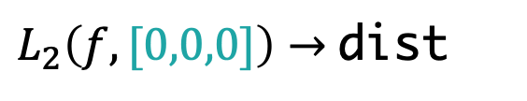
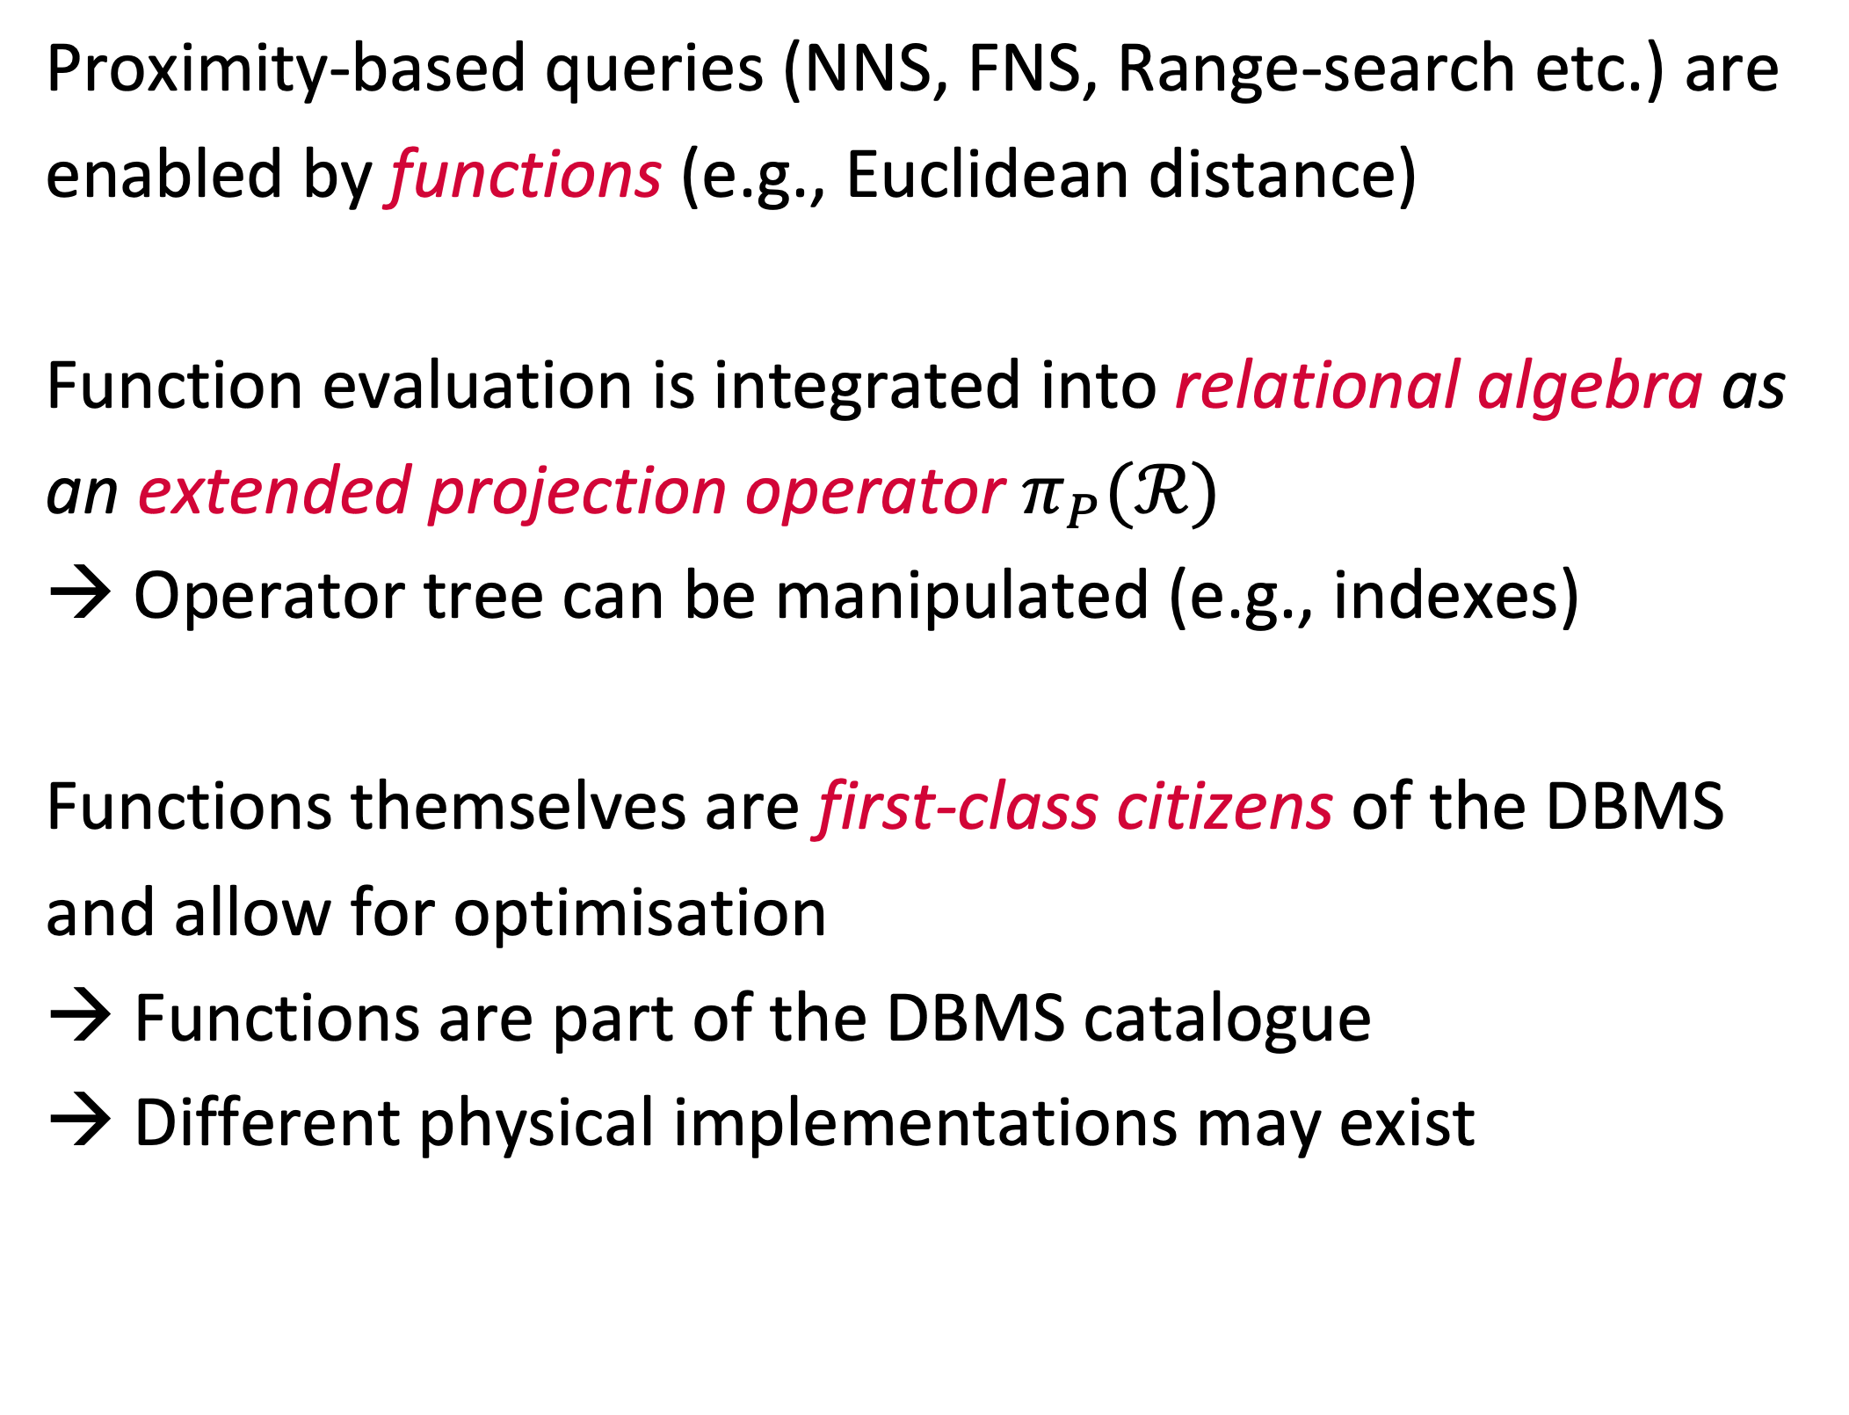
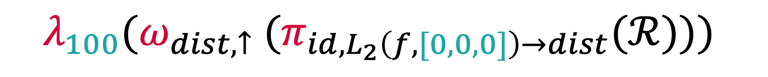
A Relational Model to Accommodate Proximity Based Queries Outline
Query
Proximity-based queries (NNS, FNS, Range-search etc.) are enabled by functions (e.g., Euclidean distance)
Function evaluation is integrated into relational algebra as an extended projection operator $π_{P}(ℛ)$
→ Operator tree can be manipulated (e.g., indexes)
Functions themselves are first-class citizens of the DBMS and allow for optimisation
Functions are part of the DBMS catalogue
Different physical implementations may exist
select id, L2(f, [0,0,0]) as distance from paintings order by distance asc limit 100
Logical
$$λ_{100}({ω_{dist,↑} (π}_{id,L_{2}\left(f, [0,0,0]\right)→dist}(ℛ)))$$
Physical
Scan
paintings
Function
$L_{2}\left(f,[0,0,0]\right)→$dist
NNS
Order
dist asc
Limit
100
Project
id,dist

Slide 11
A Relational Model to Accommodate Proximity Based Queries Planning and Optimisation using Indexes
Class 1
Class 2
Class 3
Scan
Scan
Scan
Function
Function
Function
Order
Order
Limit
Index ”replaces” function execution.
Example: PQ [1]
Index can replace function execution and induces order.
Example: Cached Results
Index covers a specific edge case (e.g., NNS, FNS).
Example: VAF [2]
[1] Jégou et al. (2011). Product Quantization for Nearest Neighbor Search.
[2] Weber et al. (1998). A Quantitative Analysis and Performance Study for Similarity-Search Methods in High-Dimensional Spaces.
Notes:
Idea of replacement classes: Type of operators that can be replaced by an index.

Slide 12
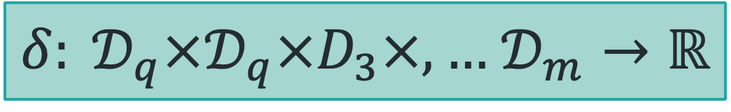


A Relational Model to Accommodate Proximity Based Queries Planning and Optimising on a Function Level
General Function
$$f:𝒟_{1}×,…,𝒟_{m}→𝒟$$
Any function known to the DBMS
(function registry).
Distance Function Class
$δ: 𝒟_{q}×𝒟_{q}×D_{3}×,…$ $𝒟_{m}→ℝ$
A distance function that can be used to
compare vectors.
Query Context
A logical implementation of a distance function (e.g., certain arguments become constants)
Logical Implementation
$$δ:𝒟_{q}→ ℝ$$
Physical Implementation
Scalar
Vectorised
GPU
A physical implementation of a distance function (e.g., executed as a SIMD optimised version)

Slide 13
A Relational Model to Accommodate Proximity Based Queries Planning and Optimising the Query
Class 3 Index Replacement
Scan[VAF]
Project
Scan
Scan
Scalar
Function
Function
Optimised Order & Limit
Vectorised
NNS
Order
Order & Limit
Limit
Project
Scan[PQ]
Project
Class 1 Index Replacement
Order
Limit
Project

Slide 14
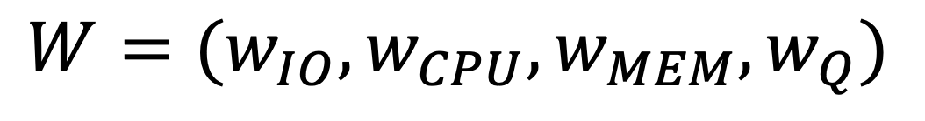
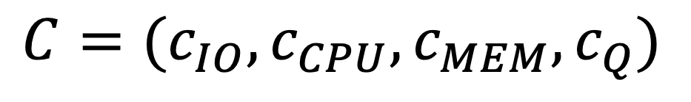
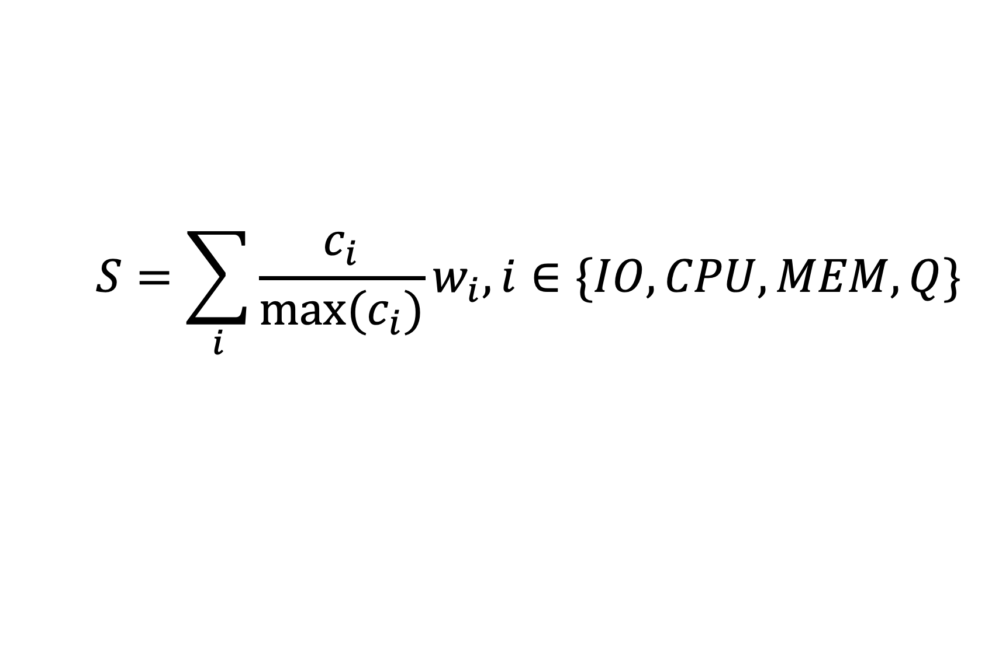
A Cost Model for Results Quality Outline
High-Dimensional Indexes often trade results quality with execution time
→ Trade-off between cost factors (CPU, IO etc.)
DBMS must be aware of this trade-off and take it into account during query planning
→ Cost model including quality
Cost policy to express user preference
Mechanism to empirically estimate ”quality cost” of using an index based on metrics such as recall or nDCG
Cost
$$C=(c_{IO},c_{CPU}, c_{MEM}, c_{Q})$$
Cost Policy
$$W=(w_{IO},w_{CPU}, w_{MEM}, w_{Q})$$
Cost Score
$$S=\sum_{i}{\frac{c_{i}}{{max⁡(c}_{i})}w_{i}, i∈\{IO,CPU,MEM,Q\}}$$

Slide 15

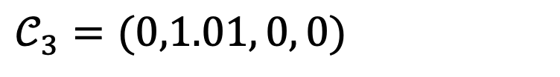

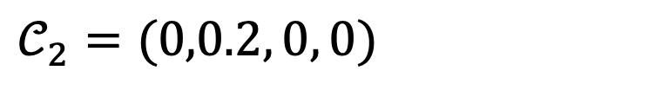
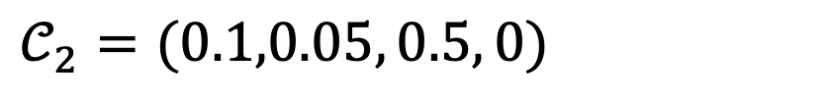


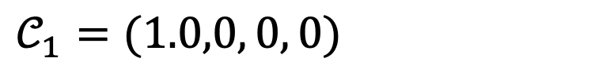

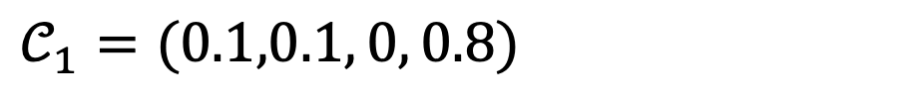

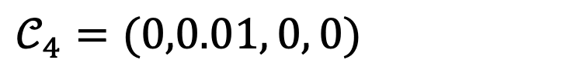
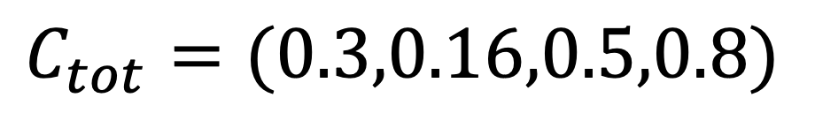
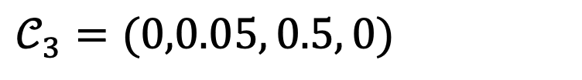
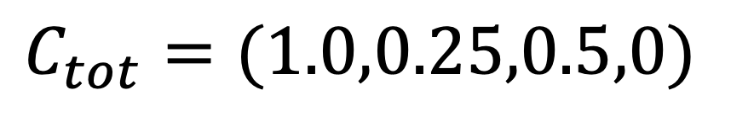
A Cost Model for Results Quality Comparing Two Execution Plans
Scan
$$𝒞_{1}=(1.0,0, 0, 0)$$
Scan[PQ]
$$𝒞_{1}=(0.1,0.1, 0, 0.8)$$
Function
$$𝒞_{2}=(0,0.2, 0, 0)$$
Order & Limit
$$𝒞_{2}=(0.1,0.05, 0.5, 0)$$
Order & Limit
$$𝒞_{3}=(0,0.05, 0.5, 0)$$
Project
$$𝒞_{3}=(0,1.01, 0, 0)$$
Project
$$𝒞_{4}=(0,0.01, 0, 0)$$
$$C_{tot}=(1.0,0.25,0.5,0)$$
$$C_{tot}=(0.3,0.16,0.5,0.8)$$
$$W=(1,0, 0,1)$$
$$W=(1,0, 0, 0)$$
$$S=1.0$$
$$S=0.3$$
$$S=1.1$$

Slide 16
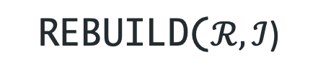

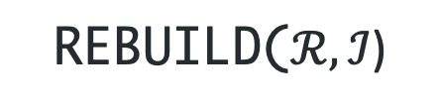
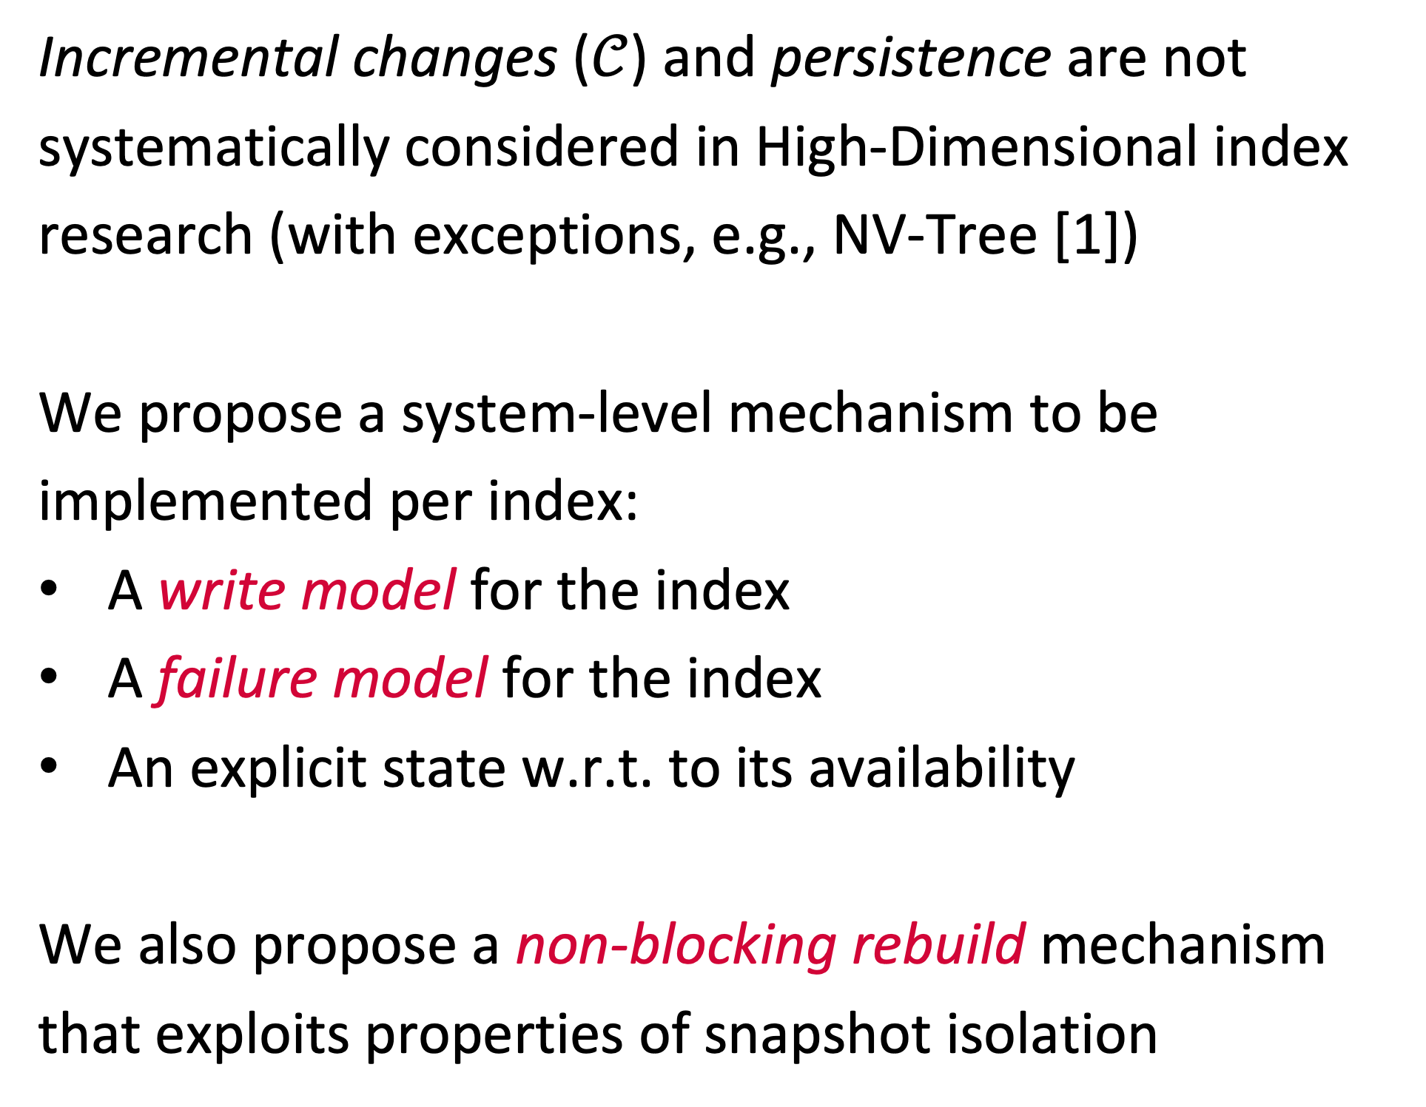
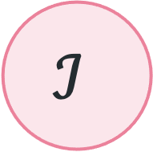



High-Dimensional Index Maintenance Outline
$$𝒞$$
Incremental changes ($𝒞$) and persistence are not systematically considered in High-Dimensional index research (with exceptions, e.g., NV-Tree [1])
We propose a system-level mechanism to be implemented per index:
A write model for the index
A failure model for the index
An explicit state w.r.t. to its availability
We also propose a non-blocking rebuild mechanism that exploits properties of snapshot isolation
$$ℐ$$
WRITEM($𝒞$)
FAILM($𝒞$)
REBUILD($ℛ,ℐ$)
CLEAN
STALE
FAILM($C$)
REBUILD($ℛ,ℐ$)
DIRTY
[1] Lejsek et al. (2008). NV-Tree: An Efficient Disk-based Index for Approximate Search in Very Large High-Dimensional Collections

Slide 17
Putting Everything Together: Cottontail DB Architecture
Multimedia Database
Column store developed in Kotlin (runs in the JVM)
Support for scalar and vector data
Boolean- and similarity search
Index support for both
Transaction support
Query model with ext. relational algebra
Cost model
Write model
Failure model
Async. index rebuild

Slide 18
Evaluation

Slide 19
Evaluation Overview
Use of the Query Model in a Mixed Query Workload
Effects of parallelism and use of indexes structures
Effects of query optimisation
Effects of adjusting cost
→ Goal: Test performance in mixed workloads
Comparison: Milvus [1] vs. Cottontail DB
→ Goal: Test performance in “big” multimedia retrieval
The Effect of Data Changes on Index Performance
→ Goal: Test applicability of write- and failure model for indexes
[1] Wang et al. (2021). Milvus – A Purpose-Built Vector Data Management System

Slide 20




Evaluation: Big Multimedia Retrieval Setup
Evaluation Setup
Yandex Deep 1B [1] dataset
5M, 10M, 100M, 1B shard
96-dimensional vectors
Execute NNS queries with random vectors
L2 distance
1 warmup, 10 repetitions
Direct comparison to Milvus [2] in single node setup
Goal:
Observe and compare execution time
Milvus
Cottontail DB
Load + Query
Query
Thread 1 Queries
Yandex Deep 1B (Query set)
[1] Babenko et al. (2016). Efficient Indexing of Billion-scale Datasets of Deep Descriptors.
[2] Wang et al. (2021). Milvus – A Purpose-Built Vector Data Management System

Slide 21
Evaluation: Big Multimedia Retrieval Results
Latency of NNS query (both plots)
Method of Data Access
Method of Data Access
Collection Size
Collection Size

Slide 22
Evaluation: Big Multimedia Retrieval Results

Slide 23
Evaluation: Big Multimedia Retrieval What About 1 Billion Entries?
Cottontail DB was capable of performing NNS for the 1B shard, however, latency numbers were far from interactive
Milvus could not perform the NNS query on the 1B shard, because the dataset did not fit into the available main memory (384 GB)
Index structures did not resolve this issue since both the index and the original data are loaded
Milvus cannot process dataset on our a single-node setup
Size | Index | Latency [s]
1B | SCAN | 339.82
1B | VAF | 387.23
1B | PQ | 65.00
Cottontail DB result on Yandex Deep 1B

Slide 24
Evaluation: High-Dimensional Index Maintenance Setup
Evaluation Setup
Yandex Deep 1B [1] dataset (1M shard)
VAF (pre-built) [2]
Write workload
90% INSERT, 10% DELETE
Out-of-distribution data (yes / no)
NNS queries with random query vectors
brute-force & with index use
Goal:
Observe speed-up (index vs. brute-force) over time
Cottontail DB
Queries
Thread 1 INSERT (90%)
DELETE (10%)
Thread 2 Queries
Yandex Deep 1B
Yandex Deep 1B (Query set)
[1] Babenko et al. (2016). Efficient Indexing of Billion-scale Datasets of Deep Descriptors.
[2] Weber et al. (1998). A Quantitative Analysis and Performance Study for Similarity-Search Methods in High-Dimensional Spaces.

Slide 25
Evaluation: High-Dimensional Index Maintenance Results (VAF Index)
Speed-up gained by index
Evaluation Setup:
VAF [1] index
Runtime 30min
90% INSERT / 10% DELETE
No out-of-distribution data
Size of data collection
Time elapsed (for both plots)
[1] Weber et al. (1998). A Quantitative Analysis and Performance Study for Similarity-Search Methods in High-Dimensional Spaces.

Slide 26
Evaluation: High-Dimensional Index Maintenance Results (VAF Index)
Evaluation Setup:
VAF [1] index
Runtime 30min
90% INSERT / 10% DELETE
Out-of-distribution data
[1] Weber et al. (1998). A Quantitative Analysis and Performance Study for Similarity-Search Methods in High-Dimensional Spaces.

Slide 27
Evaluation: High-Dimensional Index Maintenance Results (Index Rebuild / VAF Index)
Evaluation Setup:
VAF [1] index
Runtime 60min
90% INSERT / 10% DELETE
Out-of-distribution data
With rebuild after 30min
Index rebuild
[1] Weber et al. (1998). A Quantitative Analysis and Performance Study for Similarity-Search Methods in High-Dimensional Spaces.

Slide 28
Evaluation: High-Dimensional Index Maintenance Discussion
Big Multimedia Retrieval:
Single-purpose database (Milvus) vs. more general-purpose system (Cottontail DB)
Milvus faster once data has been loaded into memory.
Cottontail DB competitive if data loading is taken into account (consider use-case that relies on more than one collection)
→ Cottontail DB is way more flexible (range-search, fetching of vectors etc.)
Index Adaptiveness:
Write model for VAF index capable of handling INSERTs and DELETE
Index robust to changes as long as data remains in distribution
Out-of-distribution data leads to deterioration of index performance
Asynchronous rebuild is one way of handling this

Slide 29
Conclusion and Outlook

Slide 30
Conclusion
We introduced three models that work towards unified data management for multimedia data:
Query model to express proximity based queries (NNS, FNS, range search, etc.) in relational algebra
Cost model to express approximation through indexes and quality of query results
Write- and failure model to accommodate and maintaining high-dimensional index
→ Applicable to multimedia retrieval and multimedia analytics
We presented an implementation in the form of Cottontail DB, which is part of a multimedia retrieval stack
We have presented an evaluation on top of Cottontail DB that demonstrates the feasibility of the query- and the cost model.

Slide 31
Future Work
Learning to Index
Index performance highly dependent on configuration
Finding the right hyper-parameters is a manual task
Self-adaptiveness when data is changing data
Quality in Complex Plans
Quality guarantees for indexes (upper-bounds) and simple queries
Error propagation in complex plans (e.g., JOIN, SUB-SELECT)
Extended Query Model
Fuzzy operations (e.g., similarity joins)
More advanced paradigms (RNNS)
Index support for new query methods
Vectorisation & SIMD
From iterator to batch-model
End-to-end optimisation for vectorised operations
New storage model
Compression

Slide 32
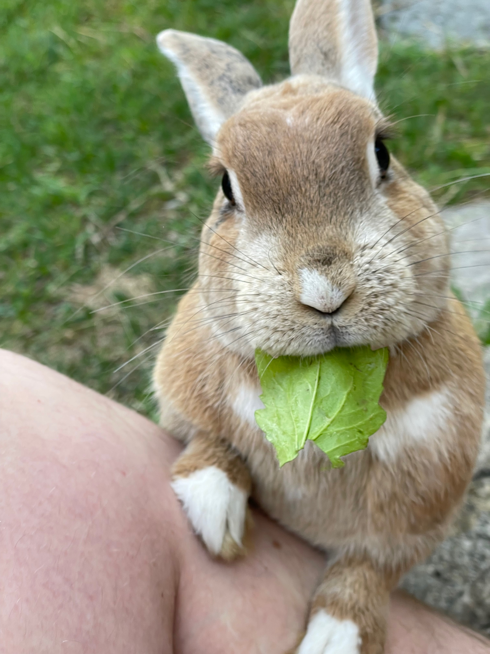
Thank you!
Questions?
Ralph Gasser
ralph.gasser@unibas.ch
Databases and Information Systems (DBIS) Group, Department of Mathematics and Computer Science, University of Basel

Slide 33
Backup Slides (Definitions)

Slide 34
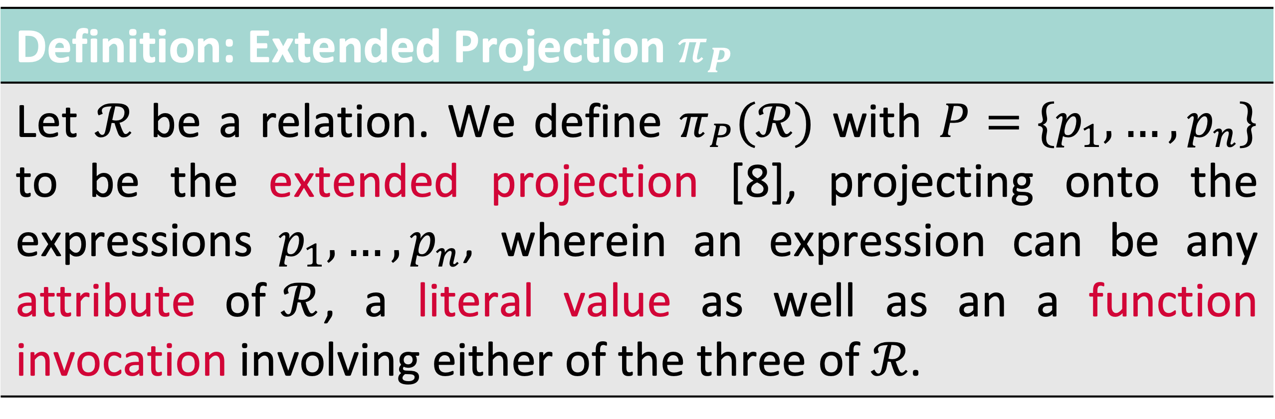
Relational Algebra Extensions Extended Projection
Definition: Extended Projection $π_{P}$
Let $ℛ$ be a relation. We define $π_{P}(ℛ)$ with $P=\{p_{1},…,p_{n}\}$ to be the extended projection [8], projecting onto the expressions $p_{1},…,p_{n}$, wherein an expression can be any attribute of$ℛ$, a literal value as well as an a function invocation involving either of the three of $ℛ$.
Observation #1: Projection may involve evaluation of a distance function → We call this a proximity based query
Observation #2: Domain of a function is an implicit extended projection
→ Functions can be nested

Slide 35
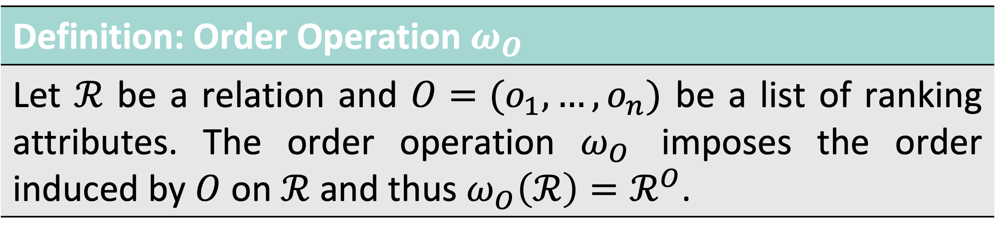
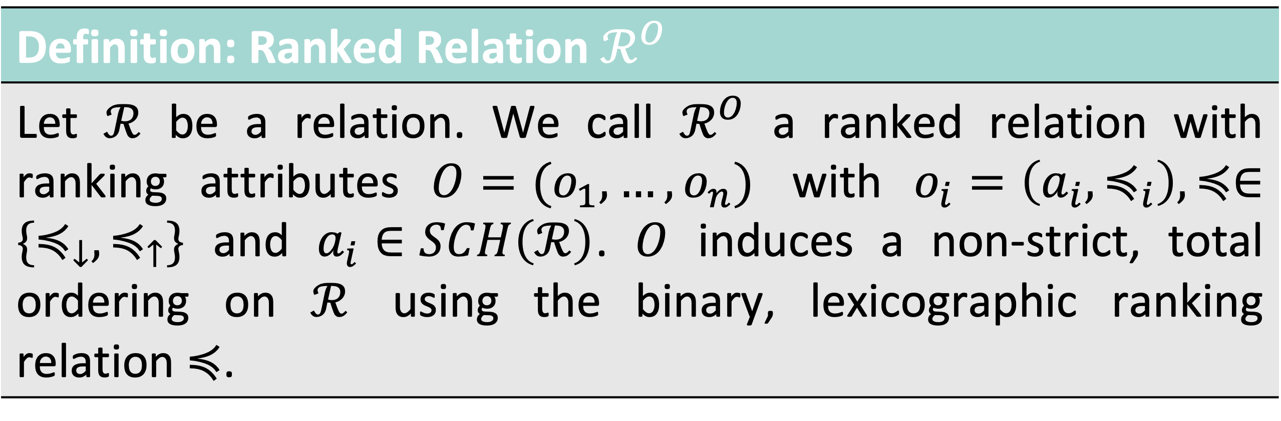
Relational Algebra Extensions Ranked Relations and Order
Definition: Ranked Relation $ℛ^{O}$
Let $ℛ$ be a relation. We call $ℛ^{O}$ a ranked relation with ranking attributes $O=(o_{1},…,o_{n})$ with $o_{i}=\left(a_{i},≼_{i}\right), ≼∈\{≼_{↓},≼_{↑}\}$ and $a_{i}∈SCH\left(ℛ\right)$. $O$ induces a non-strict, total ordering on $ℛ$ using the binary, lexicographic ranking relation $≼$.
Definition: Order Operation $ω_{O}$
Let $ℛ$ be a relation and $O=(o_{1},…,o_{n})$ be a list of ranking attributes. The order operation $ω_{O}$ imposes the order induced by $O$ on $ℛ$ and thus $ω_{O}\left(ℛ\right)=ℛ^{O}$.

Slide 36
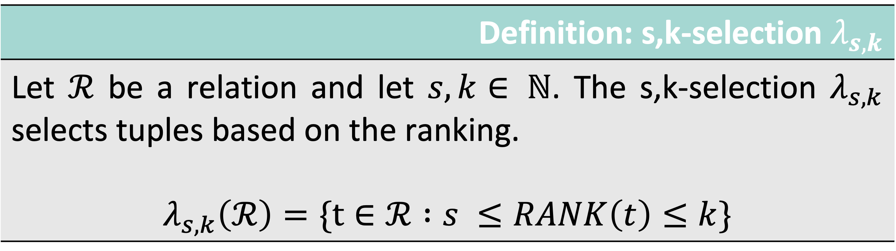
Relational Algebra s,k-selection
Definition: s,k-selection $λ_{s,k}$
Let $ℛ$ be a relation and let $s,k∈ ℕ$. The s,k-selection $λ_{s,k}$ selects tuples based on the ranking. $$λ_{s,k}\left(ℛ\right)=\{t∈ℛ :s ≤RANK\left(t\right)≤k\}$$

Slide 37
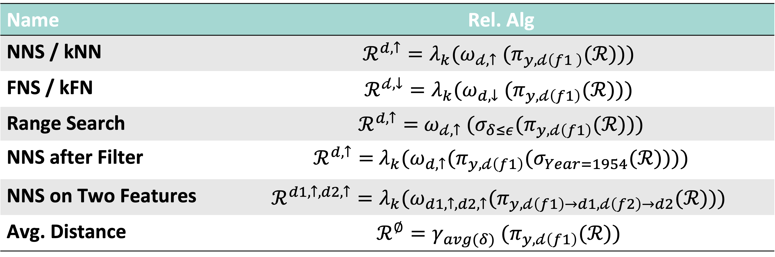
Expressing Proximity Based Queries
Name | Rel. Alg
NNS / kNN | $${ℛ^{d,↑}=λ}_{k}({ω_{𝒹,↑} (π}_{y,𝒹\left(f1 \right)}(ℛ)))$$
FNS / kFN | $$ℛ^{𝒹,↓}=λ_{k}({ω_{d,↓} (π}_{y,𝒹\left(f1\right)}(ℛ)))$$
Range Search | $ℛ^{d,↑}=$ ${ω_{𝒹,↑} (σ_{δ≤ε}(π}_{y,𝒹\left(f1\right)}(ℛ)))$
NNS after Filter | $ℛ^{d,↑}=$ ${{λ_{k}(ω}_{d,↑}(π}_{y,𝒹\left(f1\right)}(σ_{Year=1954}(ℛ))))$
NNS on Two Features | $${ℛ^{d1,↑,d2,↑}={λ_{k}(ω}_{d1,↑,d2,↑}(π}_{y,𝒹\left(f1\right)→d1,𝒹\left(f2\right)→d2}(ℛ)))$$
Avg. Distance | $${{ℛ^{∅}=γ}_{avg(δ)} (π}_{y,𝒹\left(f1\right)}(ℛ))$$

Slide 38
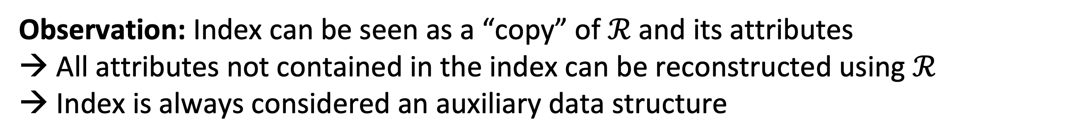
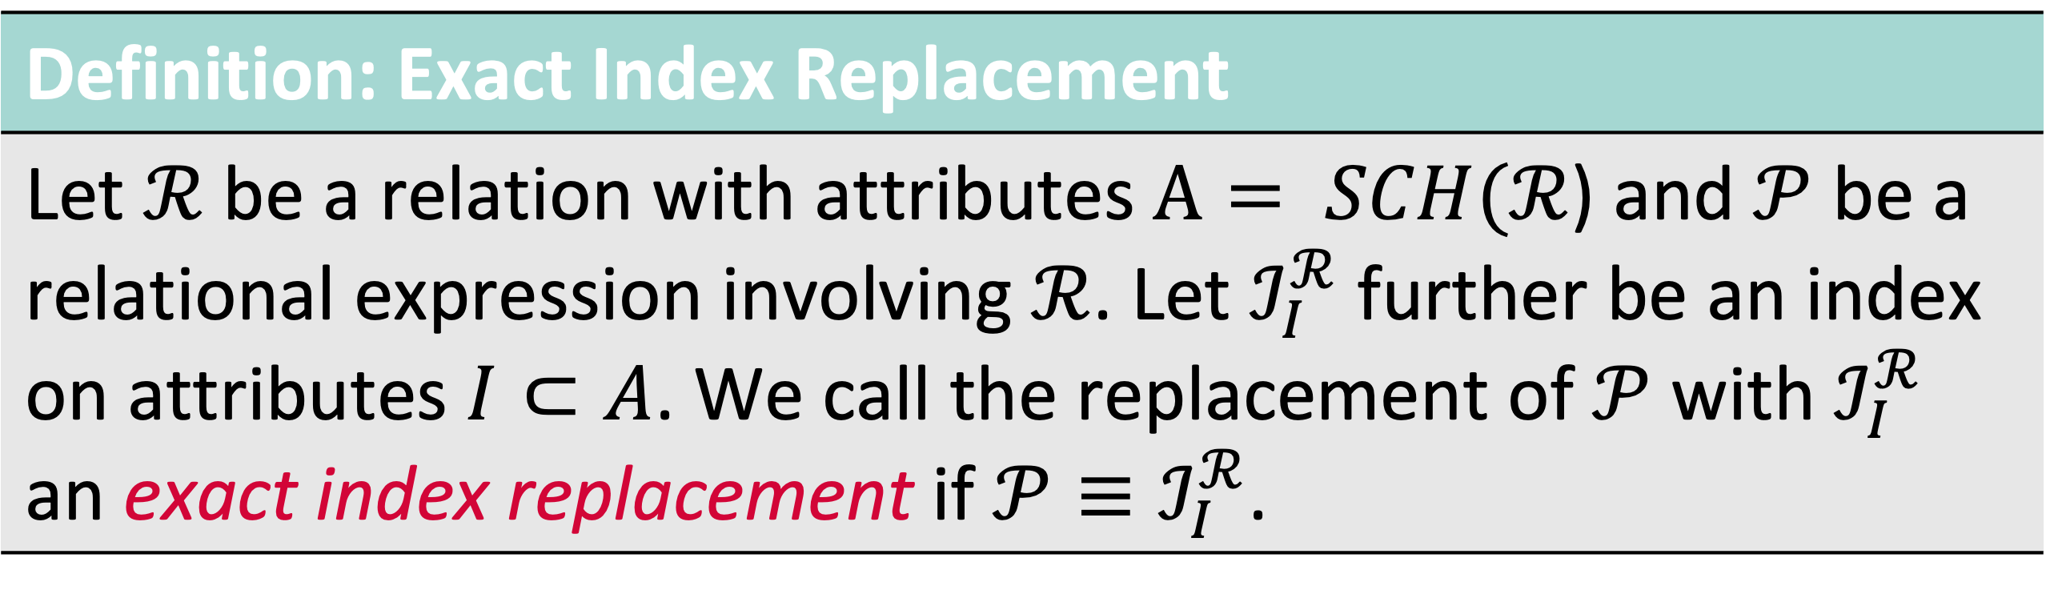
High-Dimensional Indexes and Rel. Alg. Extension
Definition: Exact Index Replacement
Let $ℛ$ be a relation with attributes $A= SCH(ℛ$) and $𝒫$ be a relational expression involving $ℛ$. Let $ℐ_{I}^{ℛ}$ further be an index on attributes $I⊂A$. We call the replacement of $𝒫$ with $ℐ_{I}^{ℛ}$ an exact index replacement if $𝒫≡ℐ_{I}^{ℛ}$.
Observation: Index can be seen as a “copy” of $ℛ$ and its attributes → All attributes not contained in the index can be reconstructed using $ℛ$
→ Index is always considered an auxiliary data structure
$$ℐ_{I}^{ℛ}⋈_{TID}π_{A}\left(ℛ\right), A=\{a:a∈SCH\left(ℛ\right) ∧a∉SCH\left(ℐ_{I}^{ℛ}\right)\}$$
“Fetch”

Slide 39
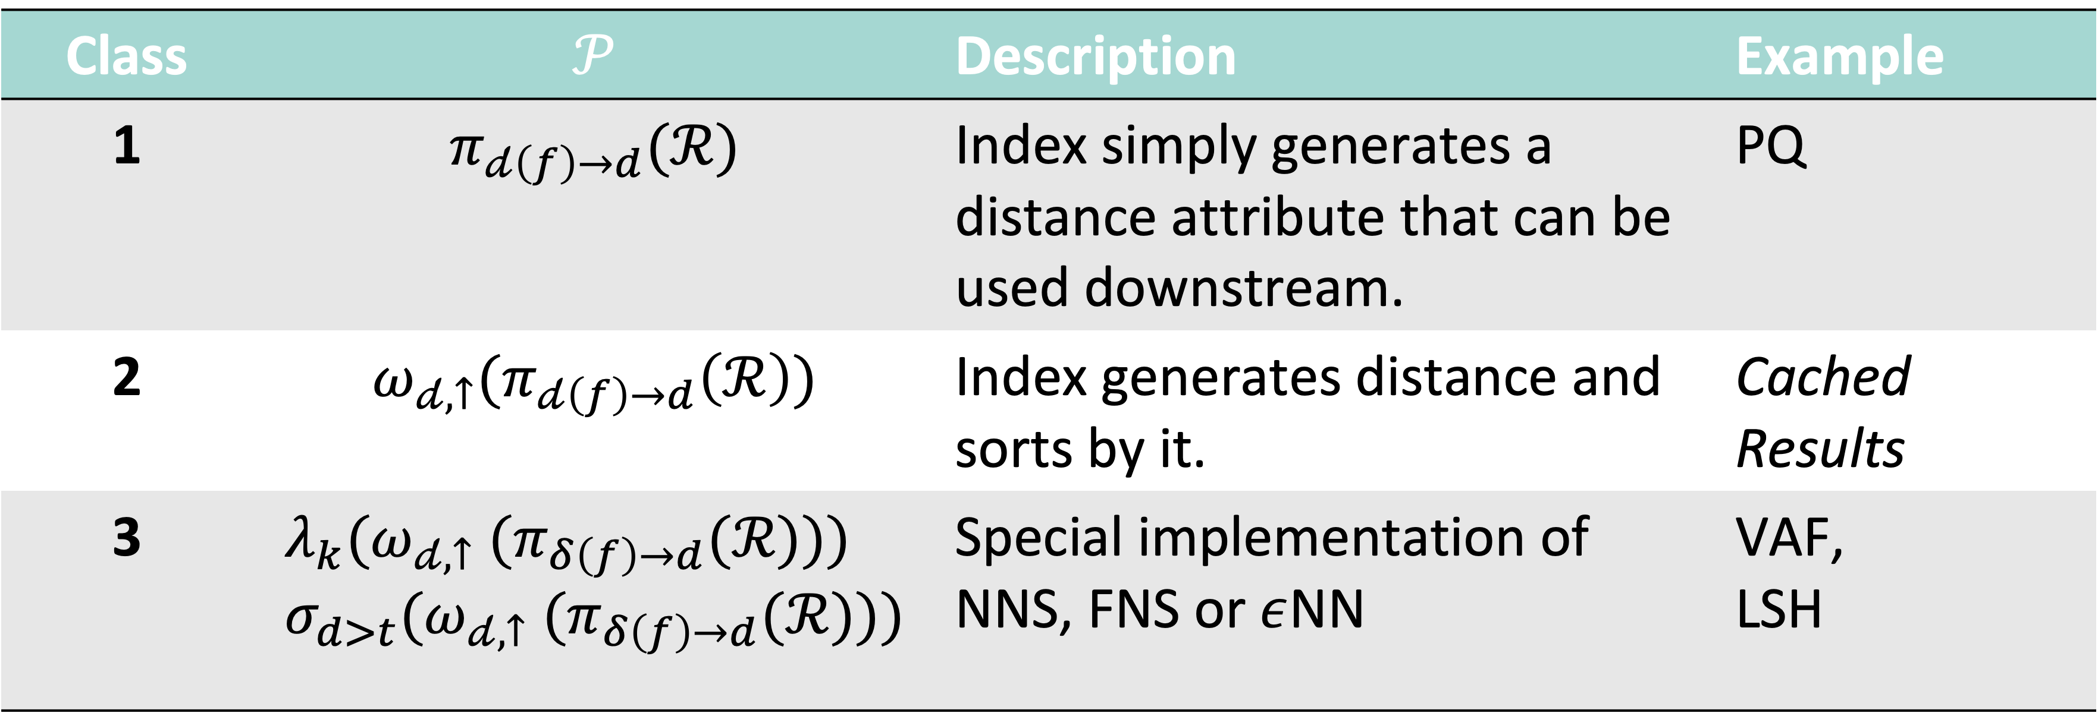
High-Dimensional Indexes and Rel. Alg. Extension
Class | $$𝒫$$ | Description | Example
1 | $$π_{𝒹\left(f\right)→d}(ℛ)$$ | Index simply generates a distance attribute that can be used downstream. | PQ
2 | $$ω_{𝒹,↑}(π_{𝒹\left(f\right)→d}\left(ℛ\right))$$ | Index generates distance and sorts by it. | Cached Results
3 | $$λ_{k}({ω_{𝒹,↑} (π}_{δ\left(f\right)→d}(ℛ))) \\ σ_{d>t}({ω_{𝒹,↑} (π}_{δ\left(f\right)→d}(ℛ)))$$ | Special implementation of NNS, FNS or $ε$NN | VAF, LSH

Slide 40
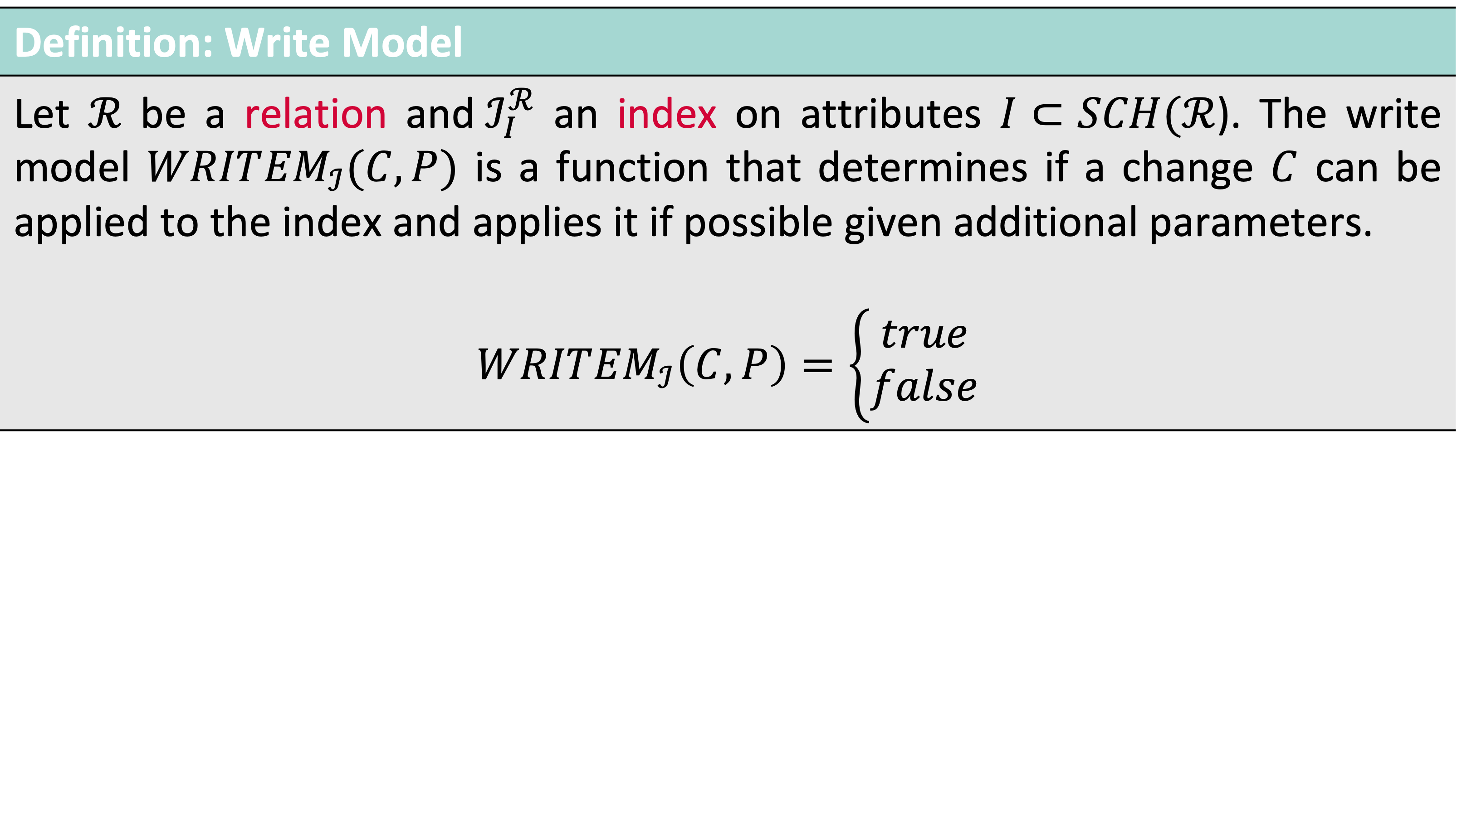
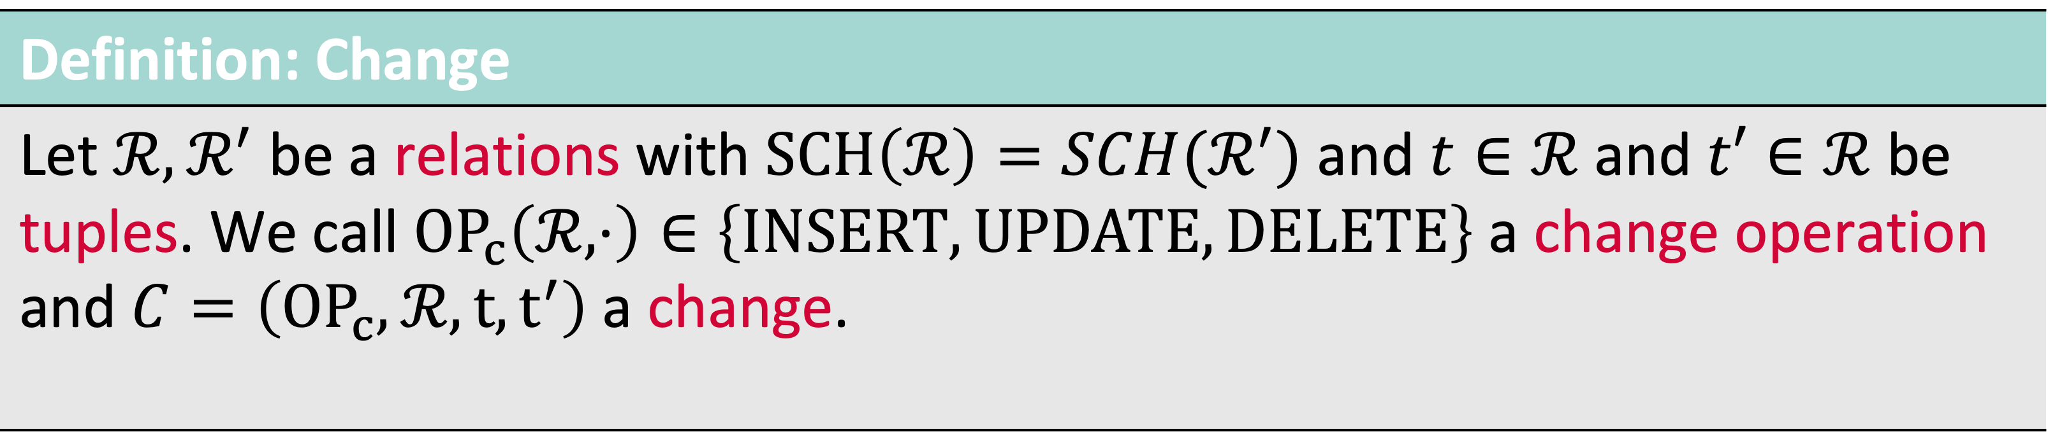
Write Model of an Index
Definition: Change
Let $ℛ,ℛ^{′}$ be a relations with $SCH\left(ℛ\right)=SCH(ℛ^{′})$ and $t∈ℛ$ and $t′∈ℛ$ be tuples. We call ${OP}_{c}\left(ℛ, ⋅\right)∈\left\{INSERT, UPDATE, DELETE\right\}$ a change operation and $C=\left({OP}_{c},ℛ,t,t^{′}\right)$a change.
Definition: Write Model
Let $ℛ$ be a relation and${ ℐ}_{I}^{ℛ}$ an index on attributes $I⊂SCH(ℛ$). The write model $WRIT{EM}_{ℐ}(C,P)$ is a function that determines if a change $C$ can be applied to the index and applies it if possible given additional parameters. $$WRIT{EM}_{ℐ}\left(C,P\right)=\left\{\begin{aligned}true \\ false\end{aligned}\right.$$

Slide 41
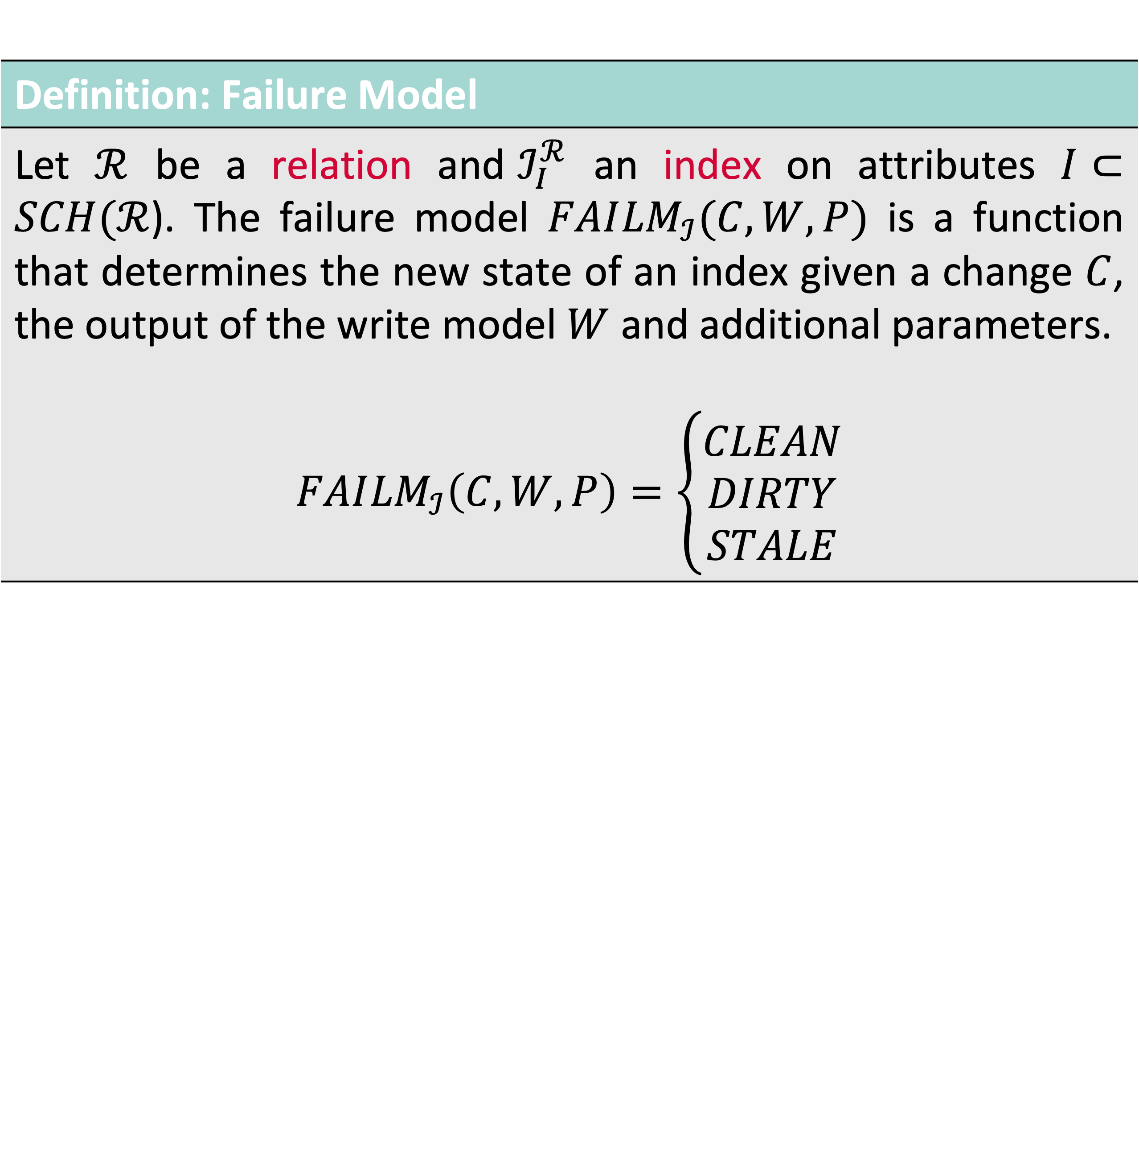
Failure Model and State of an Index
Definition: Failure Model
Let $ℛ$ be a relation and${ ℐ}_{I}^{ℛ}$ an index on attributes $I⊂SCH(ℛ$). The failure model $FAI{LM}_{ℐ}(C,W,P)$ is a function that determines the new state of an index given a change $C$, the output of the write model $W$ and additional parameters. $$FAI{LM}_{ℐ}\left(C,W,P\right)=\left\{\begin{aligned}CLEAN \\ DIRTY \\ STALE\end{aligned}\right.$$

Slide 42

High-Dimensional Index Maintenance Example: Write Model for a VA file [1]
$𝖙$( ) = = $\left({0.57 \atop \begin{aligned}0.82 \\ 0.32\end{aligned}}\right)$
= ?
= 22
Feature transformation
$$𝕆→ 𝔽$$
10
How does VAF work:
Partition vector space to create lattic (usually by component-wise min/max)
Assign every vector to cell in lattice
Store resulting signature
Upon scan, distance can be approximated and entry can be filtered (save CPU / IO)
Upon Insert / Update:
If point falls within grid → write signature
If point is out of bounds → issue
9
8
7
6
5
4
3
2
1
1
2
3
4
5
6
7
8
9
10
11

Slide 43
Backup Slides (Evaluation)

Slide 44
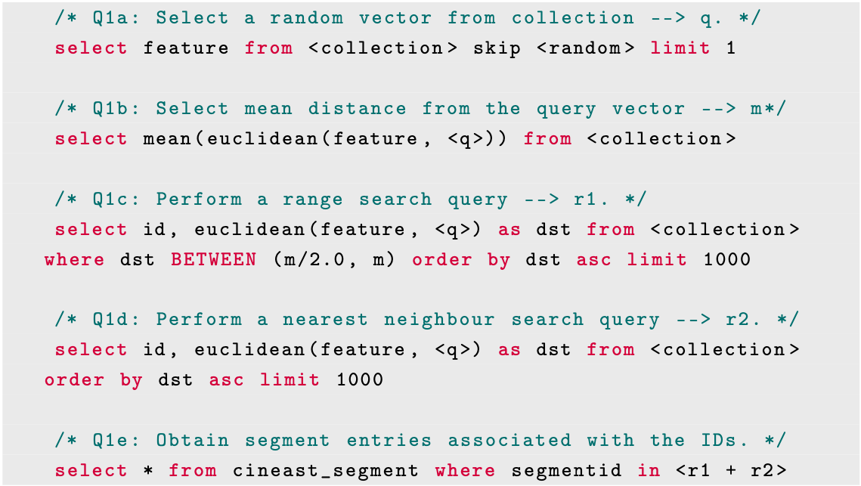
Evaluation: Query Model and the Effect of Cost Setup
Evaluation Setup
V3C [1] Dataset (different entities)
VAF & PQ-Index (pre-built) [2]
Mixed Query Workload (Q1a-Q1e)
Cost Policy set via Query Hint
→ Constant IO, CPU, Memory cost (default settings) → Increasing Quality Cost
Measurements:
Score & rank of different plan alternatives
What query plan gets selected

Slide 45
Evaluation: Query Model and the Effect of Cost Results
Proximity Based Query: select mean(L2(f, [0,0,0])) from paintings
Notes:
Available Indexes:
PQ and VAF / VAF cannot be used (class 3)
P2 vs P3 / Remove superfluous columns

Slide 46
Evaluation: Query Model and the Effect of Cost Results
Proximity Based Query: select id, L2(f, [0,0,0]) as distance from paintings order by distance asc limit 100
Notes:
Available Indexes:
PQ and VAF / VAF can be used (class 1)
P1 vs P2 / Fetch after Limit

Slide 47
Evaluation: The Effect of Changing Data Results (PQ Index)
Configuration:
PQ index [1]
Runtime 30min
90% Insert / 10% Delete
No out-of-distribution data
[1] Jégou et al. (2011). Product Quantization for Nearest Neighbor Search.

Slide 48
Evaluation: The Effect of Changing Data Results (PQ Index)
Configuration:
PQ index [1]
Runtime 60min
Index rebuild after 30 min
90% Insert / 10% Delete
Out-of-distribution data
[1] Jégou et al. (2011). Product Quantization for Nearest Neighbor Search.

Slide 49
Evaluation: Query Model and the Effect of Cost Discussion
Nearest Neighbour Search: select id, L2(f, [0,0,0]) as distance from paintings order by distance asc limit 100
Range Search: select id, L2(f, [0,0,0]) as distance from paintings where distance between <x>,<y> order by distance

Slide 50
Evaluation: Milvus vs. Cottontail DB Results: Cottontail DB

Slide 51
Evaluation: Milvus vs. Cottontail DB Results: Milvus

